Slide 1
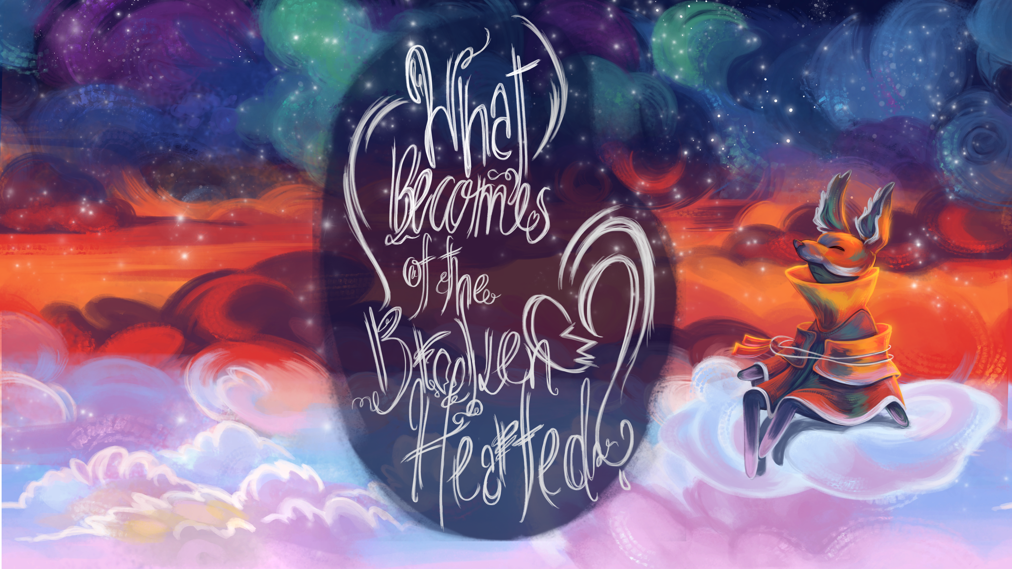

Slide 2

TARGET GROUP
ABUSIVE RELATIONSHIPS
15 – 25 y.o.
all genders
curious about love & relationships
romantics
puzzle game enthusiasts
love story enthusiasts
looking for a unique narrative experience with atmosphere
women between age 16 – 24 experience the highest rate of intimate partner violence
college students are not equipped to deal with dating abuse
- 57% find it difficult to identify
- 58% do not know how to help someone in an abusive relationship
Notes:
nearly 1.5 million high school students nationwide experience physical abuse from a dating partner in a single year
men make up ~40% of domestic violence victims each year but are mostly ignored by police and media

Slide 3

TRAILER

Slide 4


Slide 5
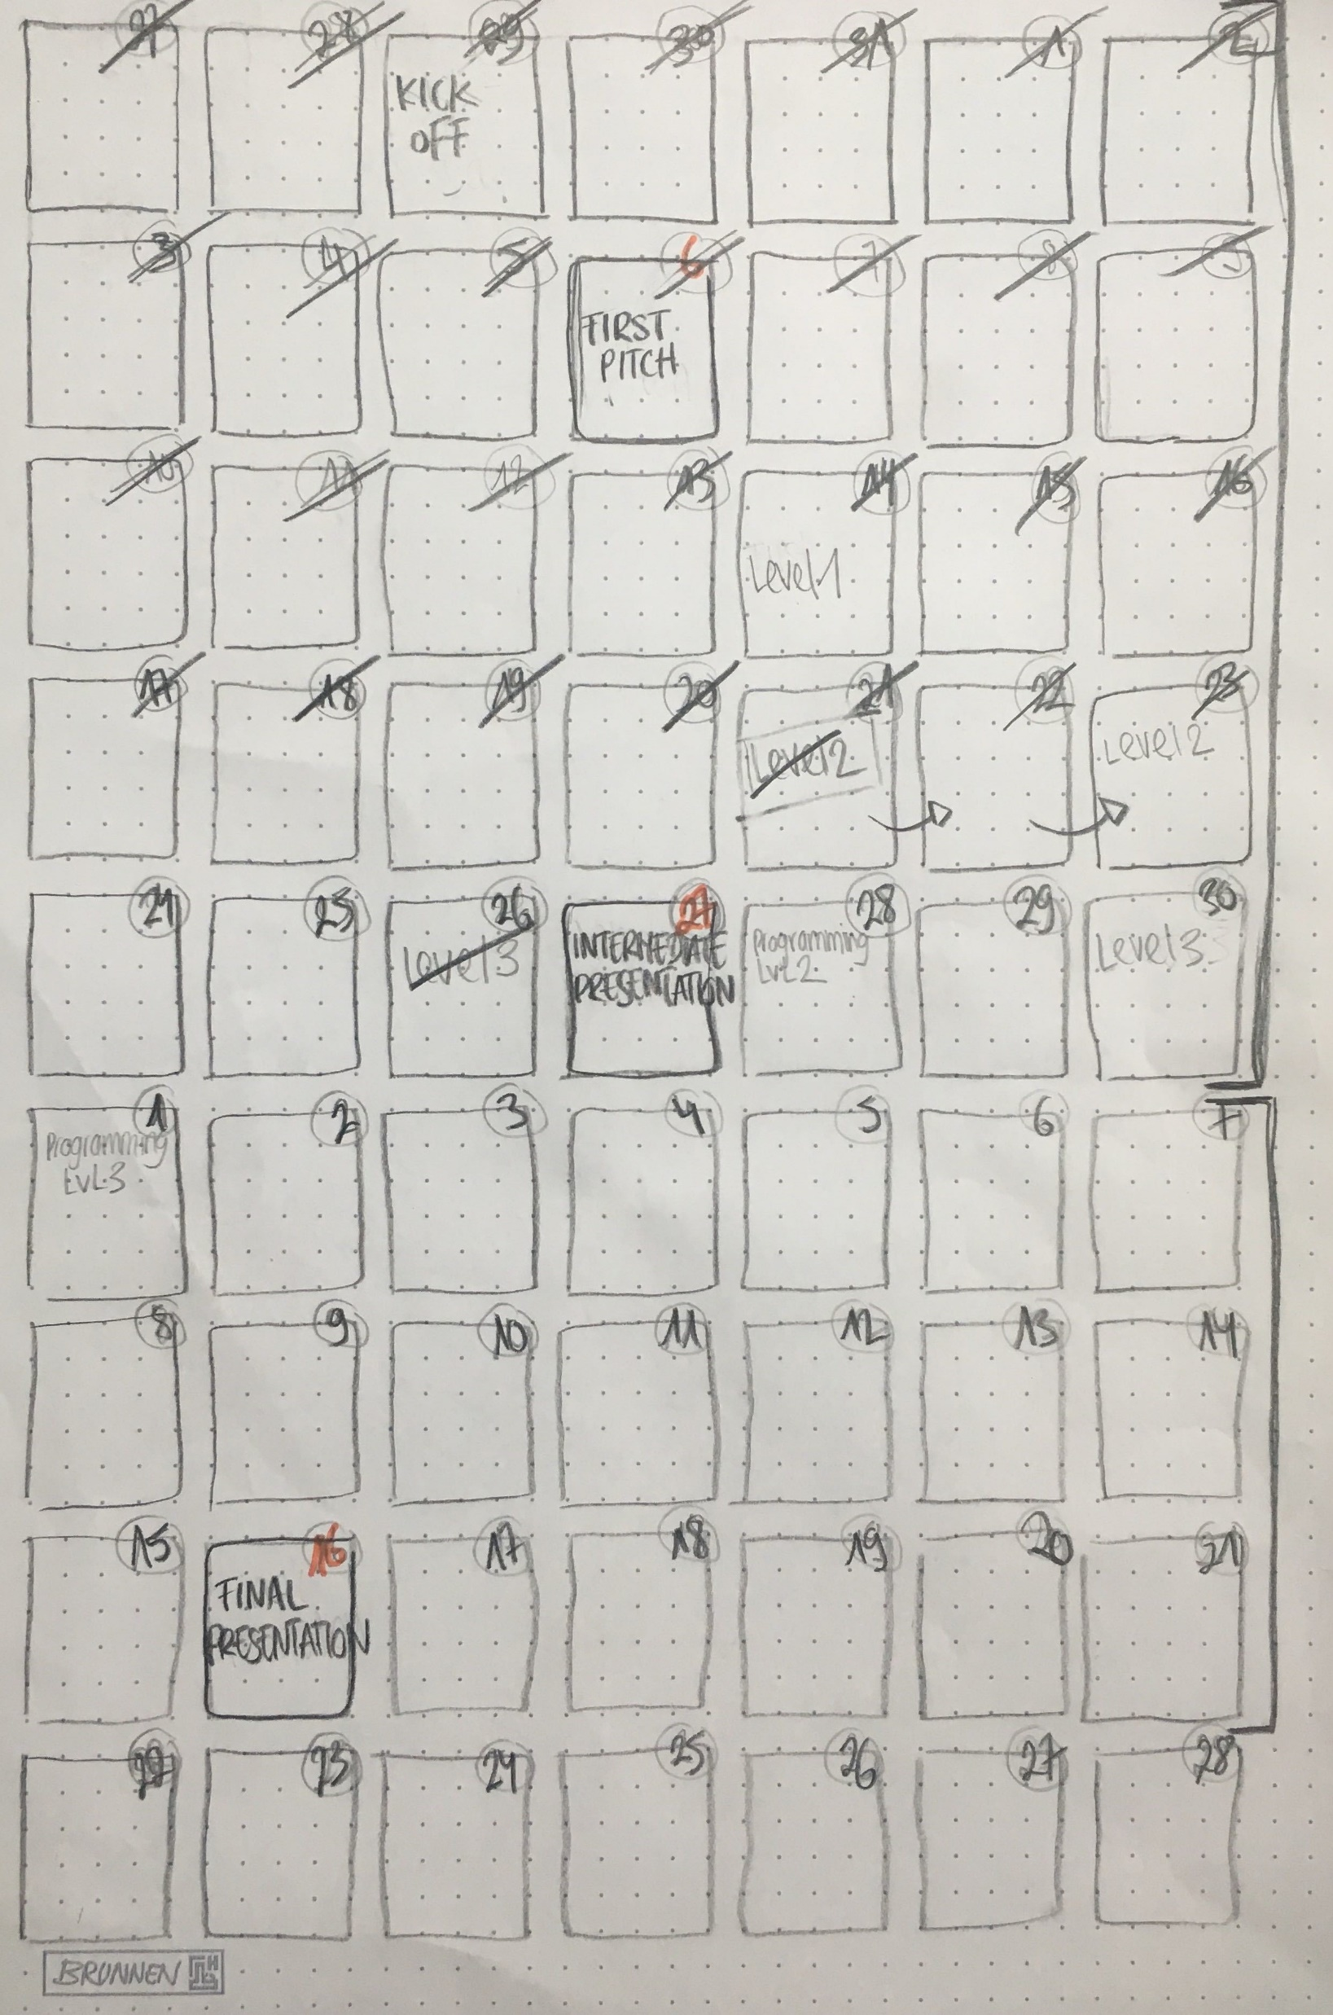
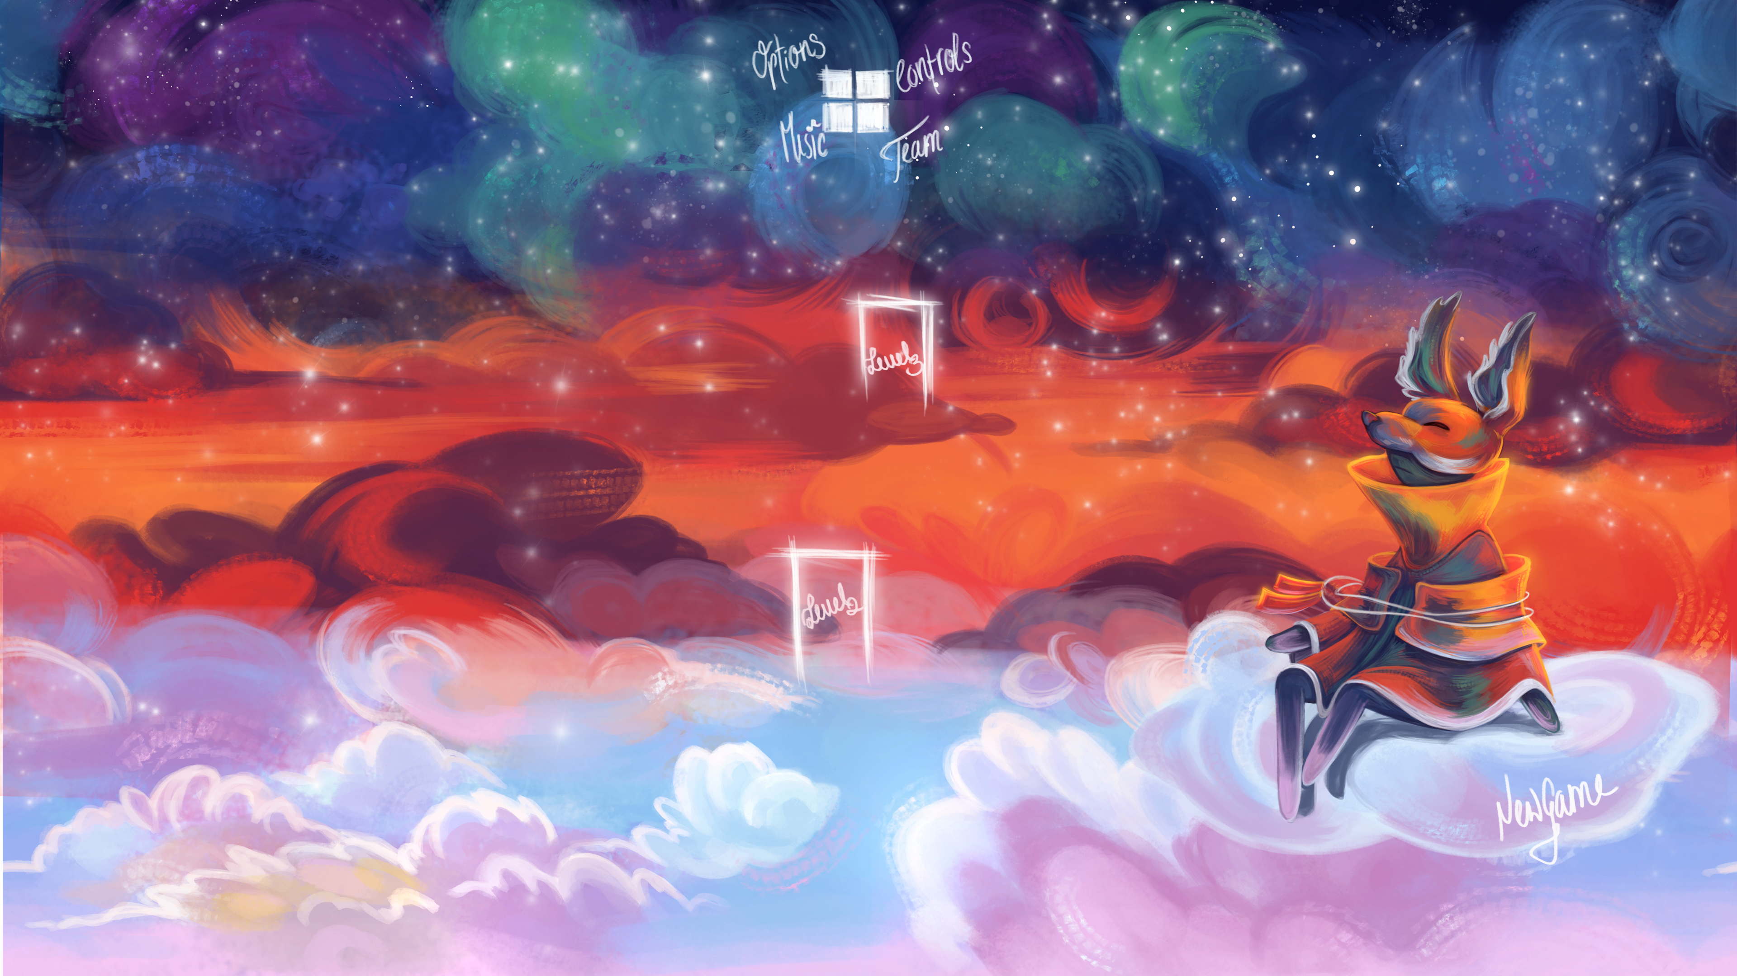
PROJECT PLAN & EXECUTION

Slide 6


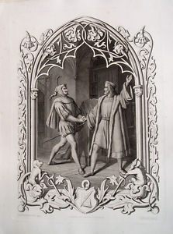

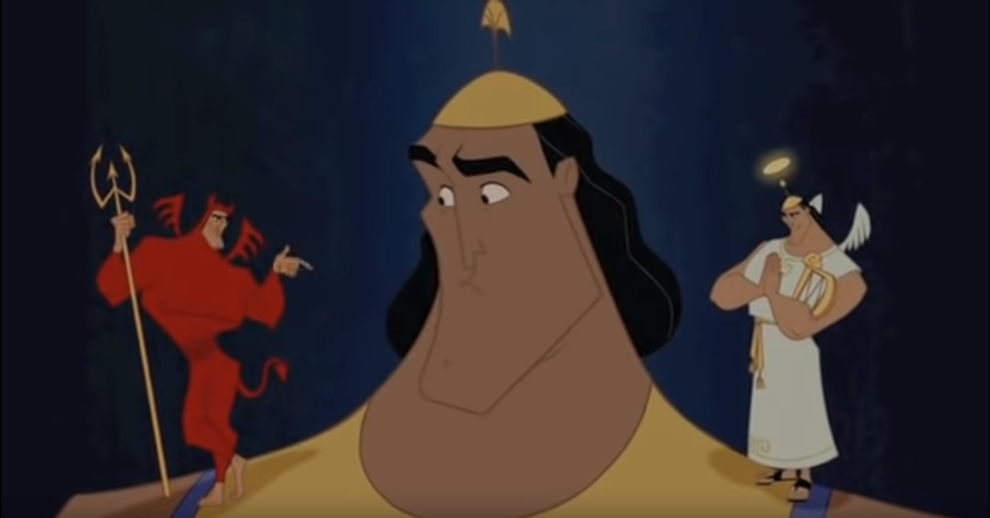
MEDIA HISTORY & EMOTIONS
1595
2015
2001
~1829
Notes:
Shakespeare explored basic human emotions of the English people. George Zito states, “The Shakespearean literature abounds with references to the purely theatrical nature of human life, the many roles one is called upon to perform, and the deceptive appearances in things” (6). He explores the basic psychology of human nature to evoke the natural emotions of the audience

Slide 7
Stairs
(Stairs to lvl 1)
Notes:
(Stairs to lvl 1)

Slide 8
Environment & Characters
LvL1
Notes:
Environment & Characters
LvL1

Slide 9
Time & Progression
LvL2
Notes:
Time & Progression
LvL2

Slide 10
Progressive Music & Technicalities
LvL3
Notes:
Progressive Music & Technicalities
LvL3

Slide 11
Thank You

